Slide 1
Machine Learning in Real World:
C4.5

Slide 2
Outline
Handling Numeric Attributes
  Finding Best Split(s)
Dealing with Missing Values
Pruning
  Pre-pruning, Post-pruning, Error Estimates
From Trees to Rules

Slide 3
Industrial-strength algorithms
For an algorithm to be useful in a wide range of real-world applications it must:
  Permit numeric attributes
  Allow missing values
  Be robust in the presence of noise
  Be able to approximate arbitrary concept descriptions (at least in principle)
Basic schemes need to be extended to fulfill these requirements
witten & eibe

Slide 4
C4.5 History
ID3, CHAID – 1960s
C4.5 innovations (Quinlan):
  permit numeric attributes
  deal sensibly with missing values
  pruning to deal with for noisy data
C4.5 - one of best-known and most widely-used learning algorithms
  Last research version: C4.8, implemented in Weka as J4.8 (Java)
  Commercial successor: C5.0 (available from Rulequest)

Slide 5
Numeric attributes
Standard method: binary splits
  E.g. temp < 45
Unlike nominal attributes,
every attribute has many possible split points
Solution is straightforward extension:
  Evaluate info gain (or other measure)
  for every possible split point of attribute
  Choose “best” split point
  Info gain for best split point is info gain for attribute
Computationally more demanding
witten & eibe

Slide 6
Weather data – nominal values
Outlook | Temperature | Humidity | Windy | Play
Sunny | Hot | High | False | No
Sunny | Hot | High | True | No
Overcast | Hot | High | False | Yes
Rainy | Mild | Normal | False | Yes
… | … | … | … | …
If outlook = sunny and humidity = high then play = no If outlook = rainy and windy = true then play = no If outlook = overcast then play = yes If humidity = normal then play = yes If none of the above then play = yes
witten & eibe

Slide 7
Weather data - numeric
Outlook | Temperature | Humidity | Windy | Play
Sunny | 85 | 85 | False | No
Sunny | 80 | 90 | True | No
Overcast | 83 | 86 | False | Yes
Rainy | 75 | 80 | False | Yes
… | … | … | … | …
If outlook = sunny and humidity > 83 then play = no If outlook = rainy and windy = true then play = no If outlook = overcast then play = yes If humidity < 85 then play = yes If none of the above then play = yes

Slide 8
Example
Split on temperature attribute:
  E.g. temperature < 71.5: yes/4, no/2
  temperature ≥ 71.5: yes/5, no/3
  Info([4,2],[5,3])
  = 6/14 info([4,2]) + 8/14 info([5,3])
  = 0.939 bits
Place split points halfway between values
Can evaluate all split points in one pass!
64 65 68 69 70 71 72 72 75 75 80 81 83 85 Yes No Yes Yes Yes No No Yes Yes Yes No Yes Yes No
witten & eibe

Slide 9
Avoid repeated sorting!
Sort instances by the values of the numeric attribute
  Time complexity for sorting: O (n log n)
Q. Does this have to be repeated at each node of the tree?
A: No! Sort order for children can be derived from sort order for parent
  Time complexity of derivation: O (n)
  Drawback: need to create and store an array of sorted indices for each numeric attribute
witten & eibe

Slide 10
More speeding up
Entropy only needs to be evaluated between points of different classes (Fayyad & Irani, 1992)
value
class
64 65 68 69 70 71 72 72 75 75 80 81 83 85 Yes No Yes Yes Yes No No Yes Yes Yes No Yes Yes No
X
Potential optimal breakpoints
Breakpoints between values of the same class cannot
be optimal

Slide 11
Binary vs. multi-way splits
Splitting (multi-way) on a nominal attribute exhausts all information in that attribute
  Nominal attribute is tested (at most) once on any path in the tree
Not so for binary splits on numeric attributes!
  Numeric attribute may be tested several times along a path in the tree
Disadvantage: tree is hard to read
Remedy:
  pre-discretize numeric attributes, or
  use multi-way splits instead of binary ones
witten & eibe

Slide 12
Missing as a separate value
Missing value denoted “?” in C4.X
Simple idea: treat missing as a separate value
Q: When this is not appropriate?
A: When values are missing due to different reasons
  Example 1: gene expression could be missing when it is very high or very low
  Example 2: field IsPregnant=missing for a male patient should be treated differently (no) than for a female patient of age 25 (unknown)

Slide 13
Missing values - advanced
Split instances with missing values into pieces
  A piece going down a branch receives a weight proportional to the popularity of the branch
  weights sum to 1
Info gain works with fractional instances
  use sums of weights instead of counts
During classification, split the instance into pieces in the same way
  Merge probability distribution using weights
witten & eibe

Slide 14
Pruning
Goal: Prevent overfitting to noise in the data
Two strategies for “pruning” the decision tree:
  Postpruning - take a fully-grown decision tree and discard unreliable parts
  Prepruning - stop growing a branch when information becomes unreliable
Postpruning preferred in practice—prepruning can “stop too early”

Slide 15
Prepruning
Based on statistical significance test
  Stop growing the tree when there is no statistically significant association between any attribute and the class at a particular node
Most popular test: chi-squared test
ID3 used chi-squared test in addition to information gain
  Only statistically significant attributes were allowed to be selected by information gain procedure
witten & eibe

Slide 16
Early stopping
 | a | b | class
1 | 0 | 0 | 0
2 | 0 | 1 | 1
3 | 1 | 0 | 1
4 | 1 | 1 | 0
Pre-pruning may stop the growth process prematurely: early stopping
Classic example: XOR/Parity-problem
  No individual attribute exhibits any significant association to the class
  Structure is only visible in fully expanded tree
  Pre-pruning won’t expand the root node
But: XOR-type problems rare in practice
And: pre-pruning faster than post-pruning
witten & eibe

Slide 17
Post-pruning
First, build full tree
Then, prune it
  Fully-grown tree shows all attribute interactions
Problem: some subtrees might be due to chance effects
Two pruning operations:
  Subtree replacement
  Subtree raising
Possible strategies:
  error estimation
  significance testing
  MDL principle
witten & eibe

Slide 18
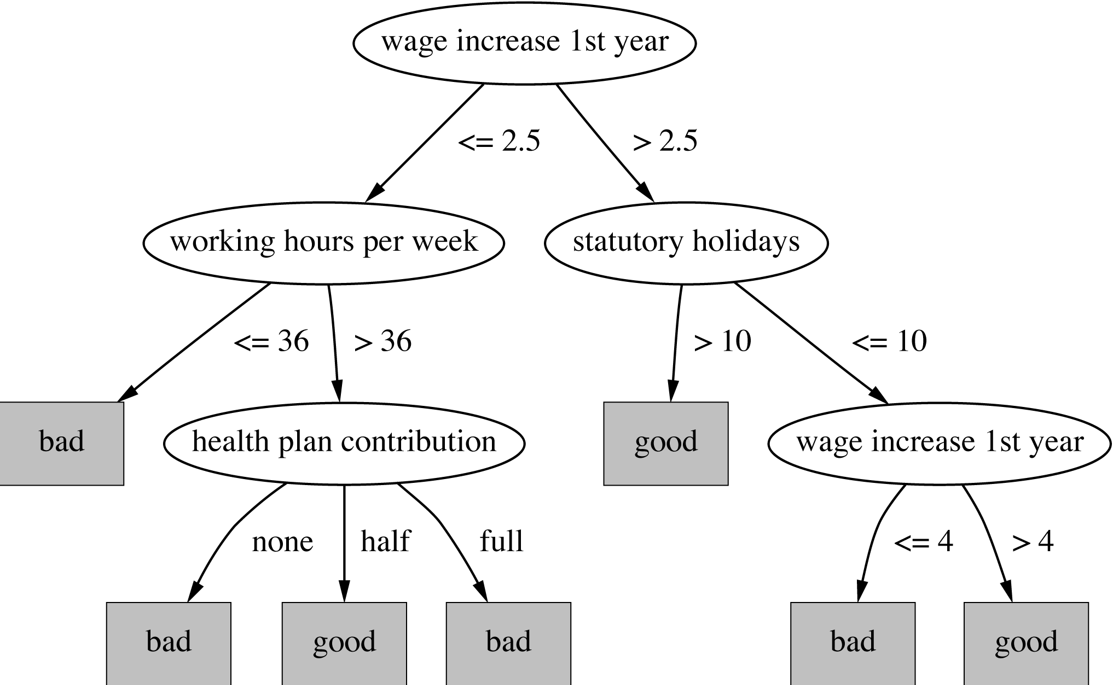
Subtree replacement
Bottom-up
Consider replacing a tree only after considering all its subtrees
Ex: labor negotiations
witten & eibe

Slide 19
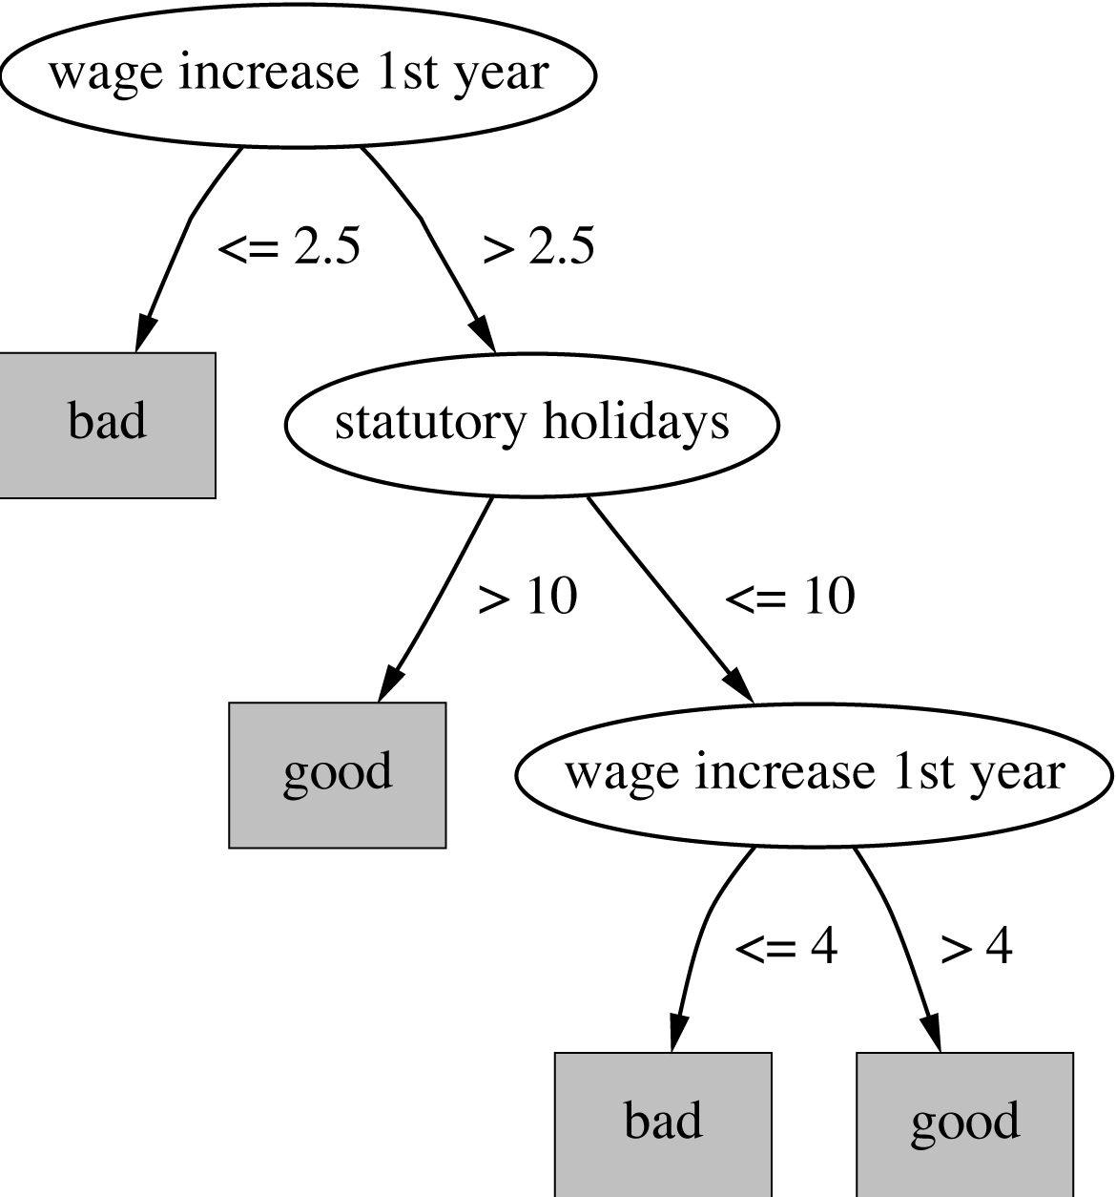
Subtree replacement
Bottom-up
Consider replacing a tree only after considering all its subtrees
witten & eibe

Slide 20
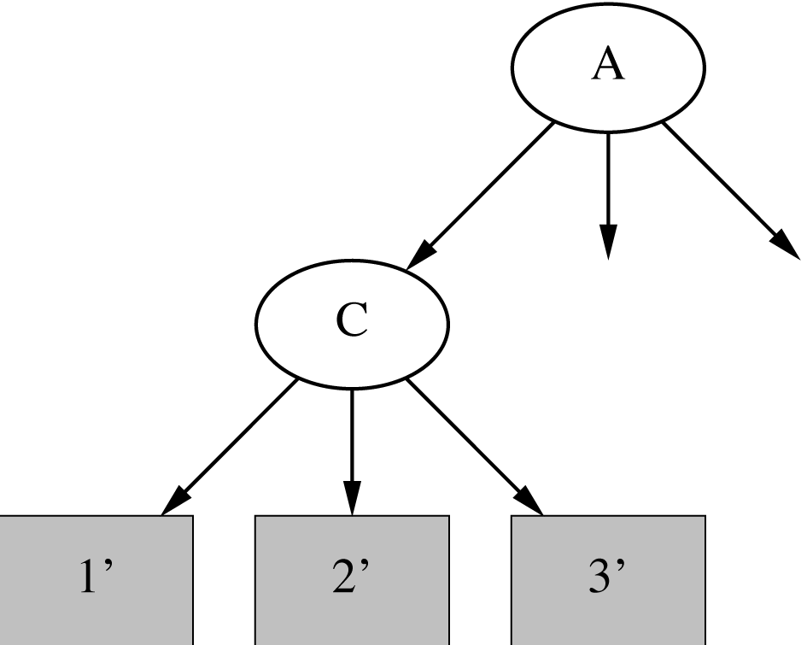
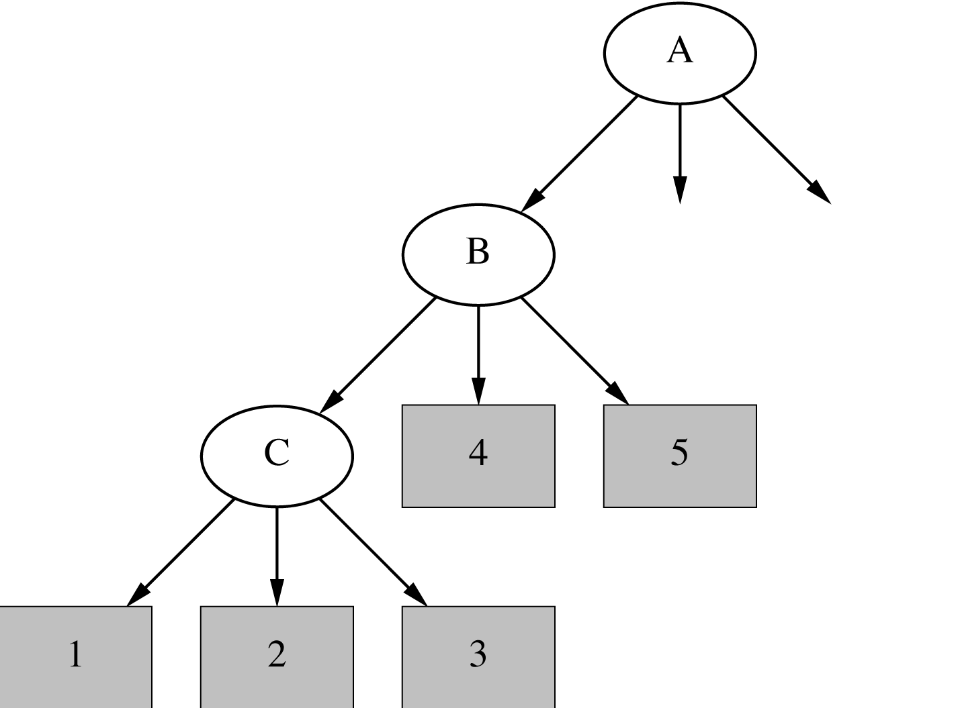
*Subtree raising
Delete node
Redistribute instances
Slower than subtree replacement
(Worthwhile?)
X
witten & eibe

Slide 21
Estimating error rates
Prune only if it reduces the estimated error
Error on the training data is NOT a useful estimator
Q: Why it would result in very little pruning?
Use hold-out set for pruning
(“reduced-error pruning”)
C4.5’s method
  Derive confidence interval from training data
  Use a heuristic limit, derived from this, for pruning
  Standard Bernoulli-process-based method
  Shaky statistical assumptions (based on training data)
witten & eibe

Slide 22

*Mean and variance
Mean and variance for a Bernoulli trial:
p, p (1–p)
Expected success rate f=S/N
Mean and variance for f : p, p (1–p)/N
For large enough N, f follows a Normal distribution
c% confidence interval [–z ≤ X ≤ z] for random variable with 0 mean is given by:
With a symmetric distribution:
witten & eibe

Slide 23
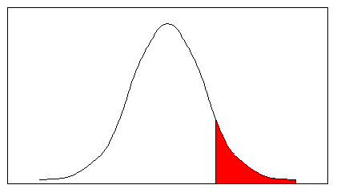
*Confidence limits
Confidence limits for the normal distribution with 0 mean and a variance of 1:
Thus:
To use this we have to reduce our random variable f to have 0 mean and unit variance
Pr[X ≥ z] | z
0.1% | 3.09
0.5% | 2.58
1% | 2.33
5% | 1.65
10% | 1.28
20% | 0.84
25% | 0.69
40% | 0.25
–1 0 1 1.65
witten & eibe

Slide 24
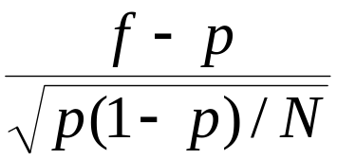
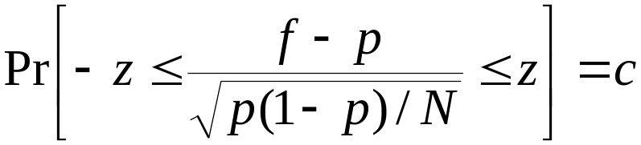
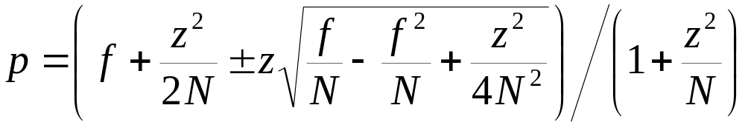
*Transforming f
Transformed value for f :
(i.e. subtract the mean and divide by the standard deviation)
Resulting equation:
Solving for p:
witten & eibe

Slide 25
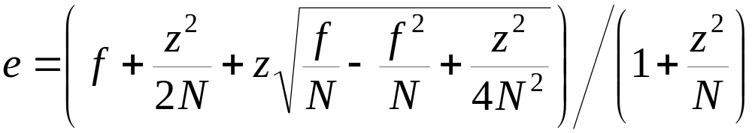
C4.5’s method
Error estimate for subtree is weighted sum of error estimates for all its leaves
Error estimate for a node (upper bound):
If c = 25% then z = 0.69 (from normal distribution)
f is the error on the training data
N is the number of instances covered by the leaf
witten & eibe

Slide 26
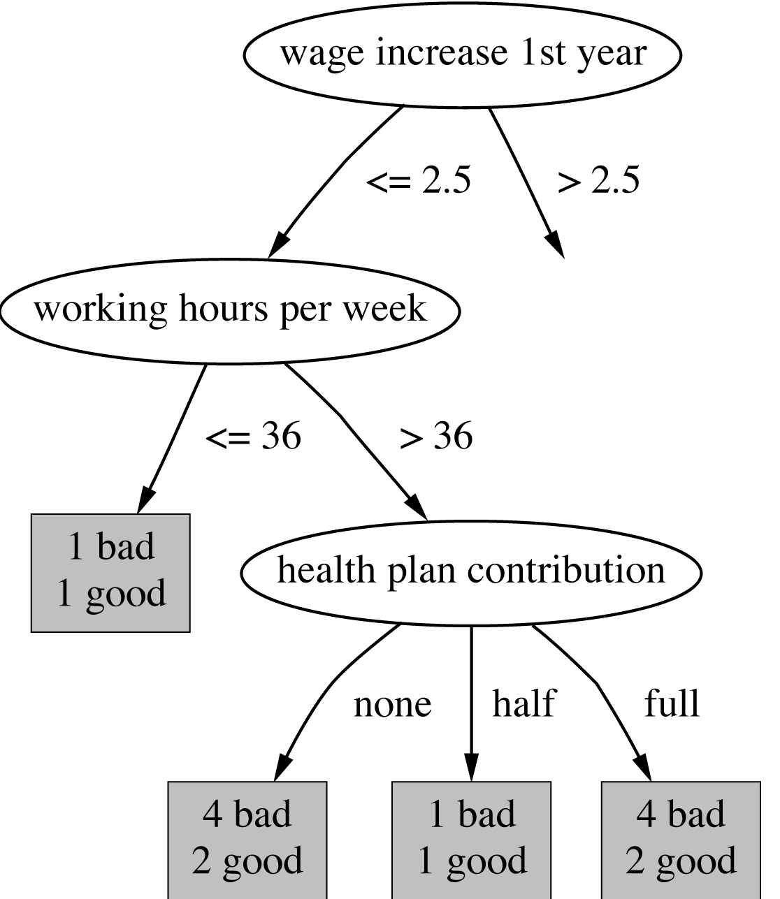
Example
f = 5/14
e = 0.46
e < 0.51
so prune!
f=0.33 e=0.47
f=0.5 e=0.72
f=0.33 e=0.47
Combined using ratios 6:2:6 gives 0.51
witten & eibe

Slide 27
*Complexity of tree induction
Assume
  m attributes
  n training instances
  tree depth O (log n)
Building a tree O (m n log n)
Subtree replacement O (n)
Subtree raising O (n (log n)²)
  Every instance may have to be redistributed at every node between its leaf and the root
  Cost for redistribution (on average): O (log n)
Total cost: O (m n log n) + O (n (log n)²)
witten & eibe

Slide 28
From trees to rules
Simple way: one rule for each leaf
C4.5rules: greedily prune conditions from each rule if this reduces its estimated error
  Can produce duplicate rules
  Check for this at the end
Then
  look at each class in turn
  consider the rules for that class
  find a “good” subset (guided by MDL)
Then rank the subsets to avoid conflicts
Finally, remove rules (greedily) if this decreases error on the training data
witten & eibe

Slide 29
C4.5rules: choices and options
C4.5rules slow for large and noisy datasets
Commercial version C5.0rules uses a different technique
  Much faster and a bit more accurate
C4.5 has two parameters
  Confidence value (default 25%):
  lower values incur heavier pruning
  Minimum number of instances in the two most popular branches (default 2)
witten & eibe

Slide 30
*Classification rules
Common procedure: separate-and-conquer
Differences:
  Search method (e.g. greedy, beam search, ...)
  Test selection criteria (e.g. accuracy, ...)
  Pruning method (e.g. MDL, hold-out set, ...)
  Stopping criterion (e.g. minimum accuracy)
  Post-processing step
Also: Decision list
vs. one rule set for each class
witten & eibe

Slide 31
*Test selection criteria
Basic covering algorithm:
  keep adding conditions to a rule to improve its accuracy
  Add the condition that improves accuracy the most
Measure 1: p/t
  t total instances covered by rule
  p number of these that are positive
  Produce rules that don’t cover negative instances,
  as quickly as possible
  May produce rules with very small coverage
  —special cases or noise?
Measure 2: Information gain p (log(p/t) – log(P/T))
  P and T the positive and total numbers before the new condition was added
  Information gain emphasizes positive rather than negative instances
These interact with the pruning mechanism used
witten & eibe

Slide 32
*Missing values, numeric attributes
Common treatment of missing values:
for any test, they fail
  Algorithm must either
    use other tests to separate out positive instances
    leave them uncovered until later in the process
In some cases it’s better to treat “missing” as a separate value
Numeric attributes are treated just like they are in decision trees
witten & eibe

Slide 33
*Pruning rules
Two main strategies:
  Incremental pruning
  Global pruning
Other difference: pruning criterion
  Error on hold-out set (reduced-error pruning)
  Statistical significance
  MDL principle
Also: post-pruning vs. pre-pruning
witten & eibe

Slide 34
Summary
Decision Trees
  splits – binary, multi-way
  split criteria – entropy, gini, …
  missing value treatment
  pruning
  rule extraction from trees
No method is always superior – experiment!
witten & eibe

